Slide 1
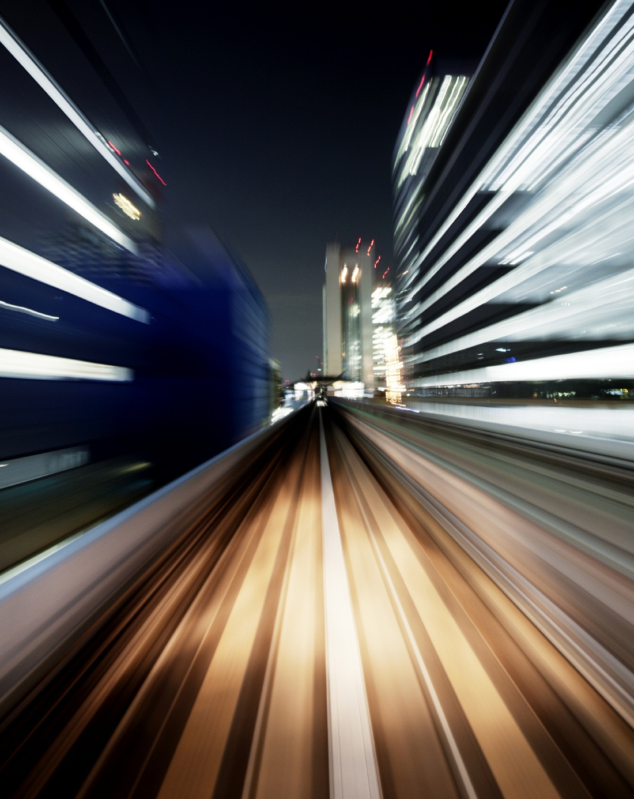
One of Facebook open source frameworks
Pythia
Notes:
Pour remplacer l’image sur cette diapositive, sélectionnez-la et supprimez-la. Cliquez ensuite sur l’icône Images dans l’espace réservé pour insérer votre image.

Slide 2
Plan
Introduction & contexte
Visual Question Answering VQA
Image Captioning IC
Use case : An artificial eye to blind
Demo
Pythia
Présentation
Behind the scene : algorithms and models
Exemple : notebook Colab
Conclusion
EvalAI Challenge
EvalAI vs Kaggle…

Slide 3
Introduction & contexte

Slide 4

Introduction & contexte
Veille technologique :
Article sur Facebook IA : Lien vers l’article

Slide 5
Introduction & contexte 1. VQA
Visual Question Answering:
Image
Question in NL*
Answer in NL*
*NL : Natural Language
https://tryolabs.com/blog/2018/03/01/introduction-to-visual-question-answering/

Slide 6
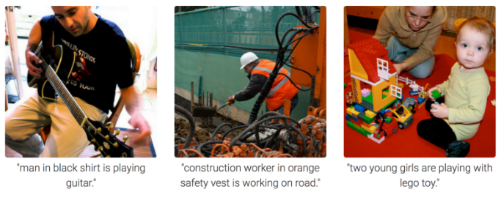
Introduction & contexte 2. Image Captioning
Image Captioning:
the process of generating textual description of an image, using :
NLP
Computer Vision
https://towardsdatascience.com/image-captioning-in-deep-learning-9cd23fb4d8d2
https://towardsdatascience.com/image-captioning-in-deep-learning-9cd23fb4d8d2

Slide 7
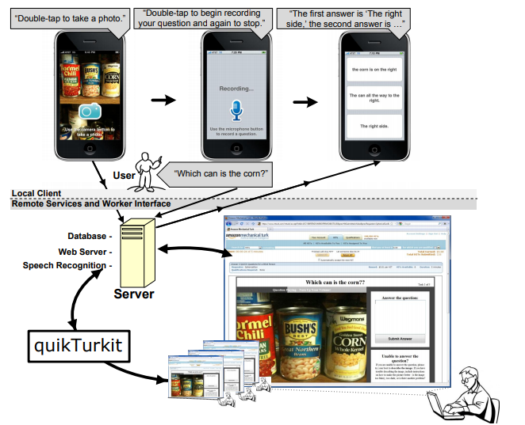
Introduction & contexte 3. Use case : an artificial eye to blind
Be my eye TEDx copenhagen
VizWiz mobile application on iphone
http://up.csail.mit.edu/other-pubs/vizwiz.pdf

Slide 8

Introduction & contexte 3.Demo
Demo

Slide 9
Pythia

Slide 10
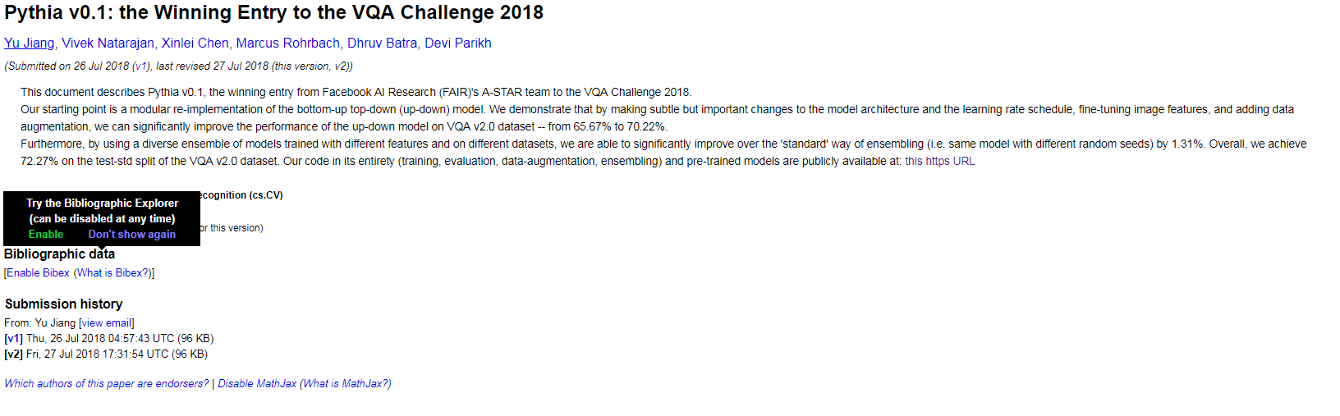
Pythia 0. avant-propos
Cornell University :
https://arxiv.org/abs/1807.09956

Slide 11
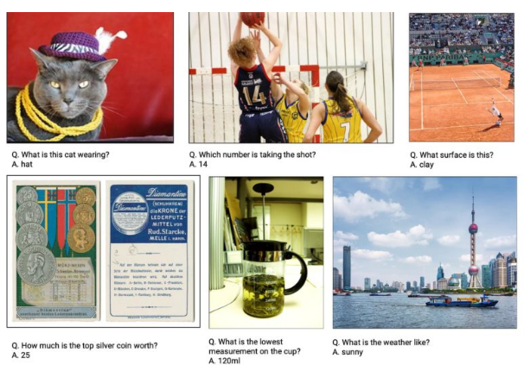
Pythia 1. Présentation
Pythia :
a deep learning framework for Visual Question Answering VQA
Built on the top of PyTorch.
https://jaxenter.com/deep-learning-pythia-facebook-158935.html

Slide 12
Pythia 2. Behind the scene : algorithms and models
Les features les plus importantes dans Pythia :
Model Zoo: LoRRA, the Pythia model, and BAN.
Distributed
Multi-tasking
Customizable (losses, metrics…)
Modules (layers)
https://jaxenter.com/deep-learning-pythia-facebook-158935.html

Slide 13
Pythia 2. Behind the scene : algorithms and models a. Focus on Pythia Model
Tuning
Top VQA algorithms
VizWiz Dataset

Slide 14
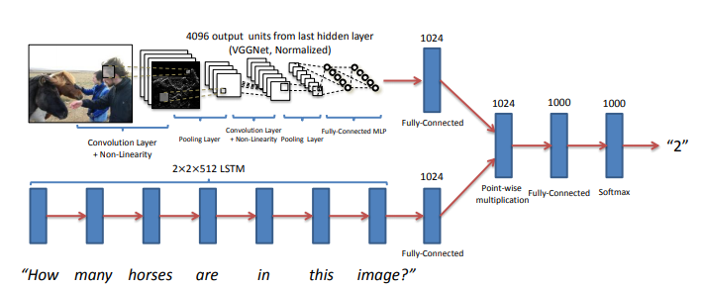
Pythia 2. Behind the scene : algorithms and models b. Top VQA algorithms
KNN
LSTM
BoW
ResNet
….
https://arxiv.org/pdf/1505.00468.pdf

Slide 15
Pythia 2. Exemple : notebook Colab
Notebook
https://arxiv.org/pdf/1505.00468.pdf

Slide 16
Conclusion

Slide 17
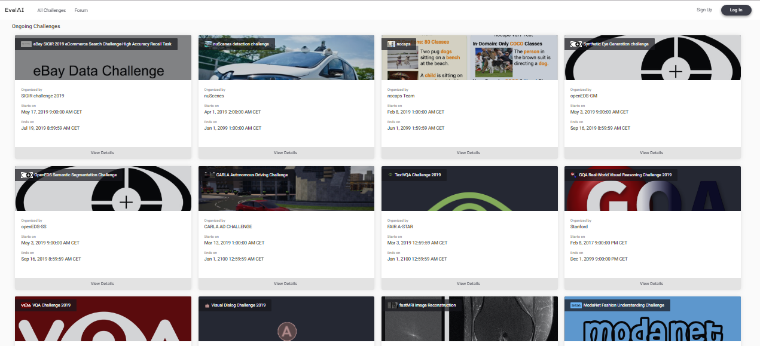
Conclusion 1. EvalAI challenges
EvalAI : an open source platform for evaluating and comparing machine learning (ML) and artificial intelligence algorithms (AI) at scale
+ VQA challenges host
https://evalai.cloudcv.org/

Slide 18
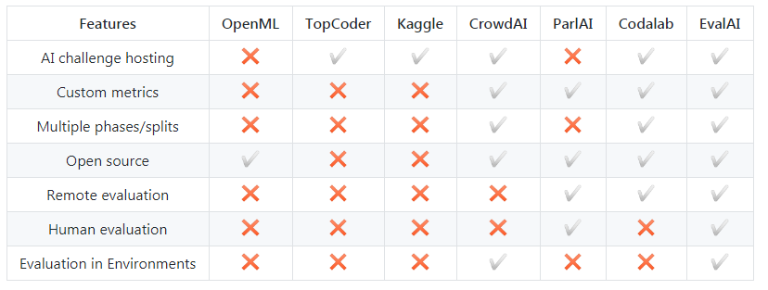
Conclusion 2. EvalAI vs Kaggle …
https://github.com/Cloud-CV/EvalAI

Slide 19

Thanks for your attention
But before , check this

